Slide 1
Dissipative dynamics of spins in Rydberg molecular gas
Ruoxi Wang

Slide 2
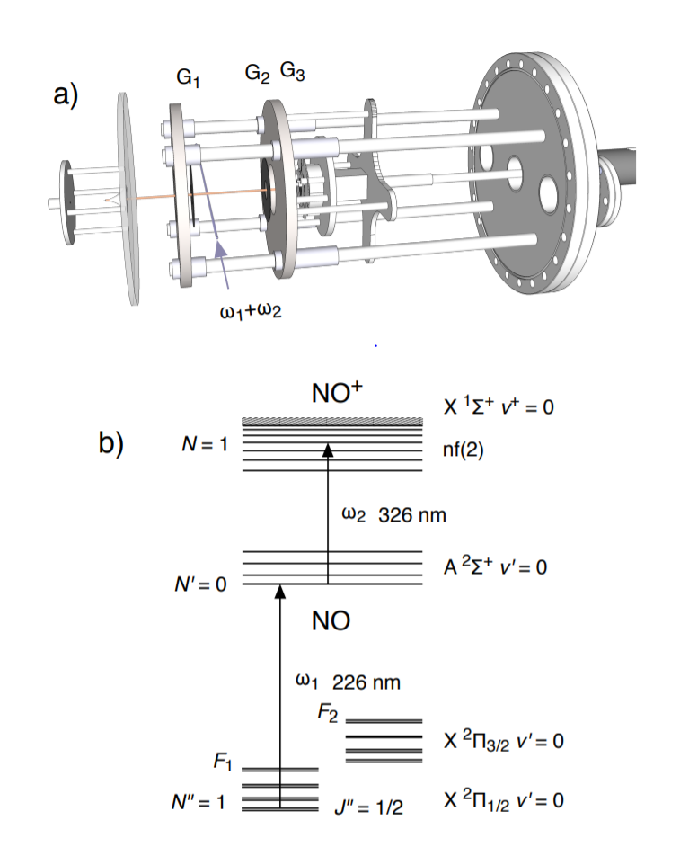
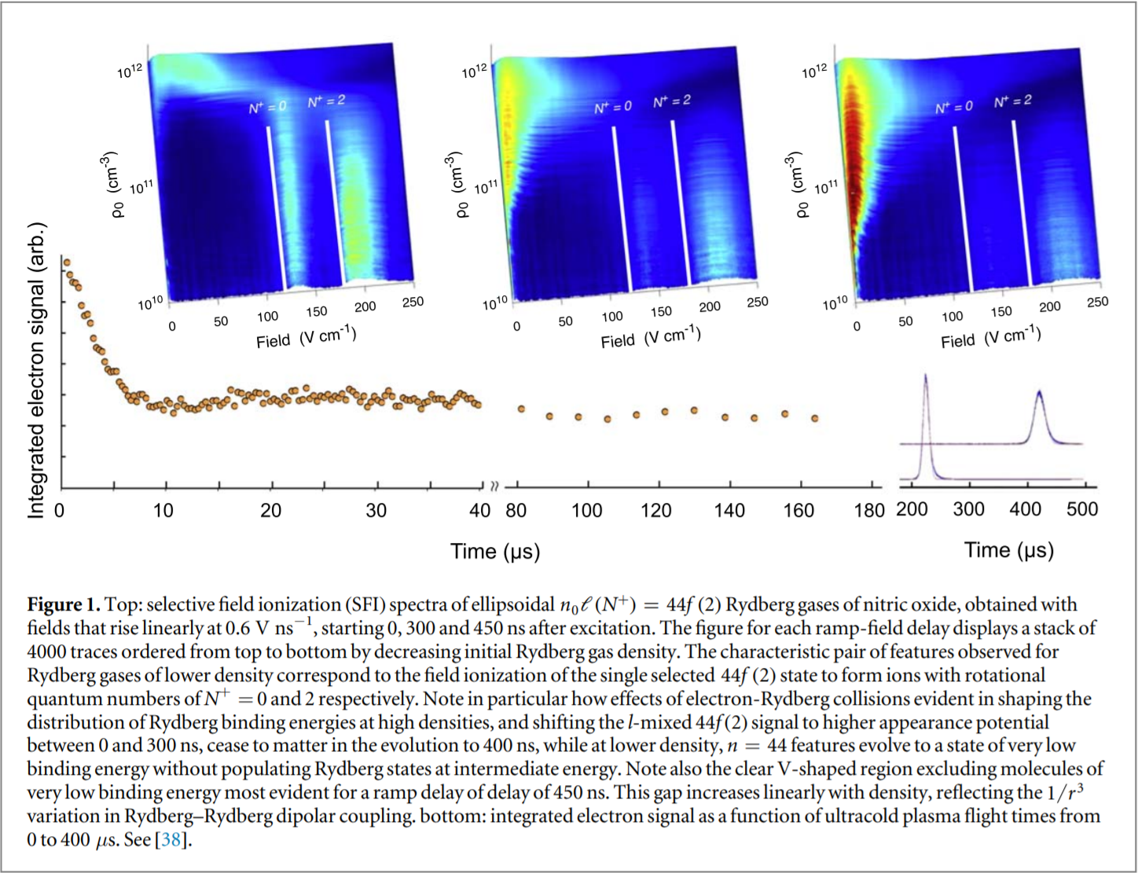
Experimental background

Slide 3
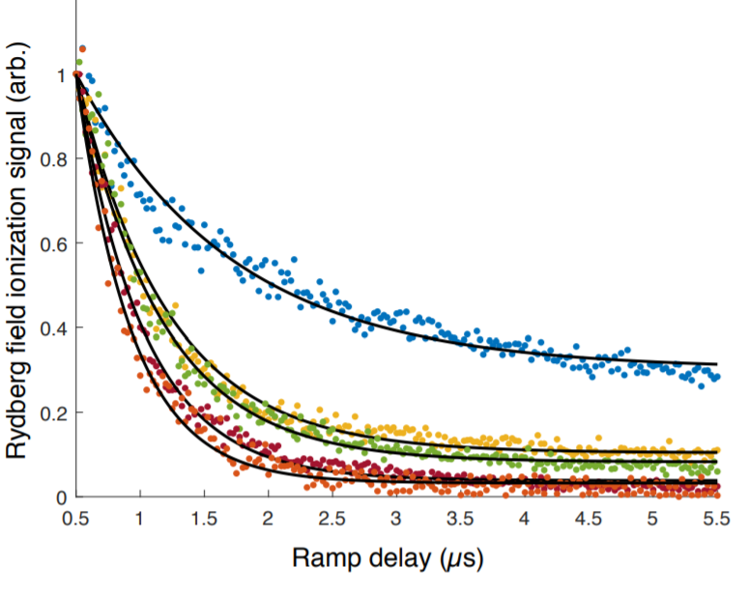
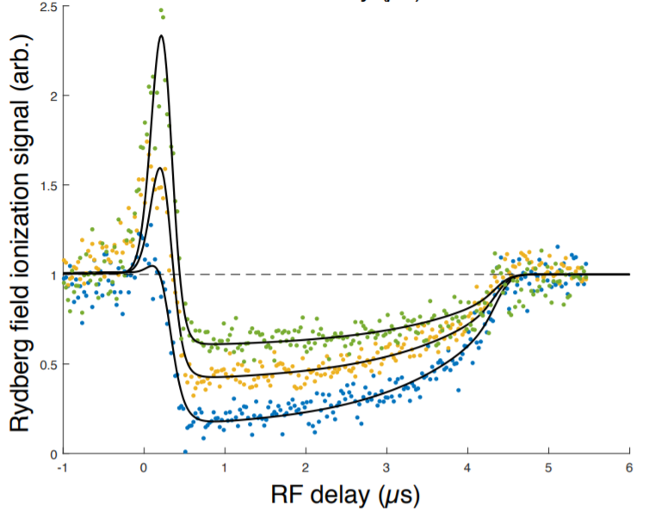
Radio frequency field-induced electron mobility
PhysRevA.102.063122

Slide 4
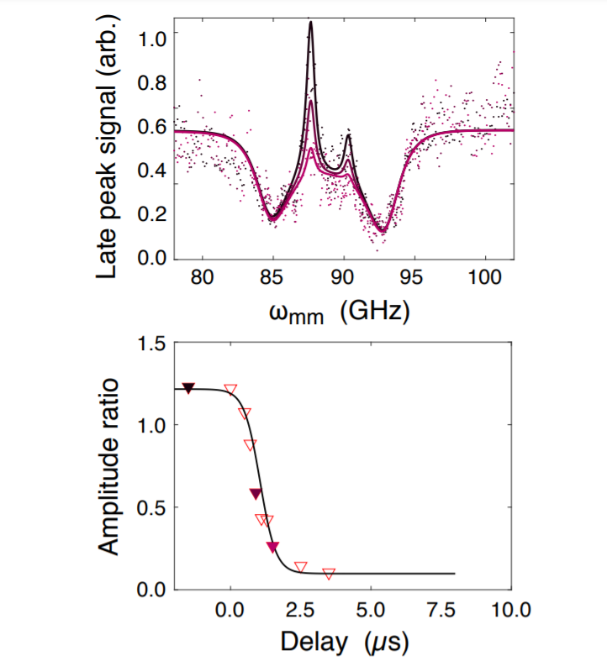

mm-wave Rydberg-Rydberg resonances
https://arxiv.org/pdf/2005.10088.pdf

Slide 5
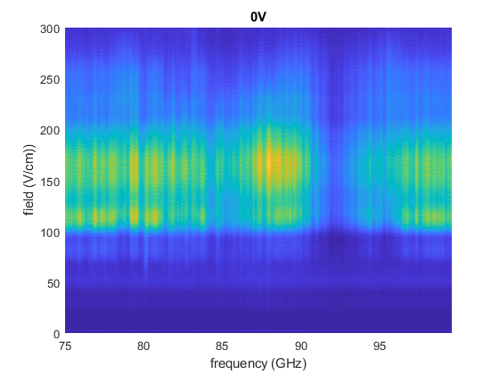
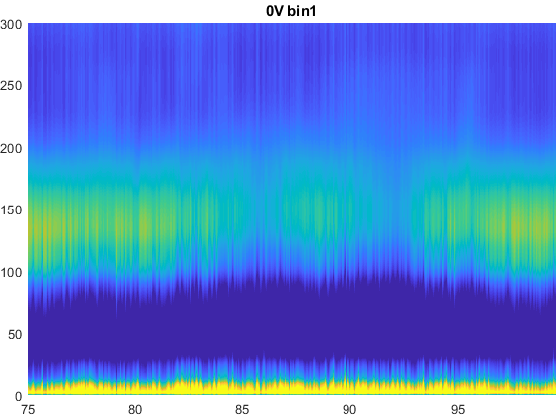
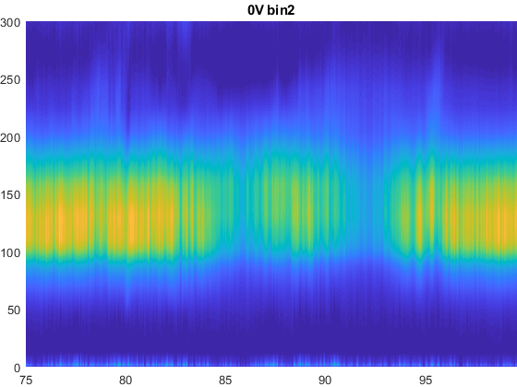
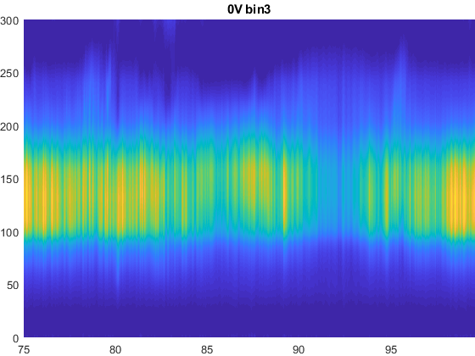
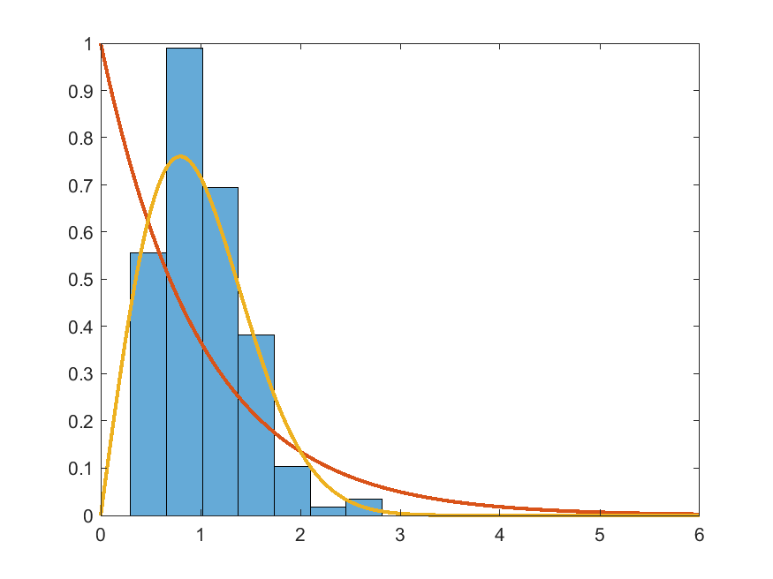
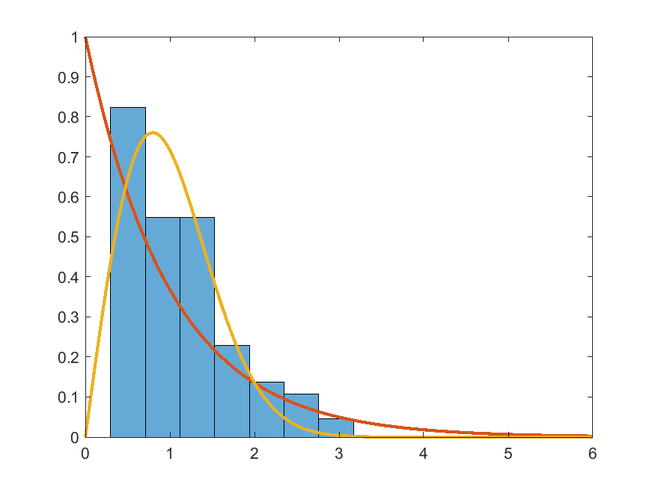
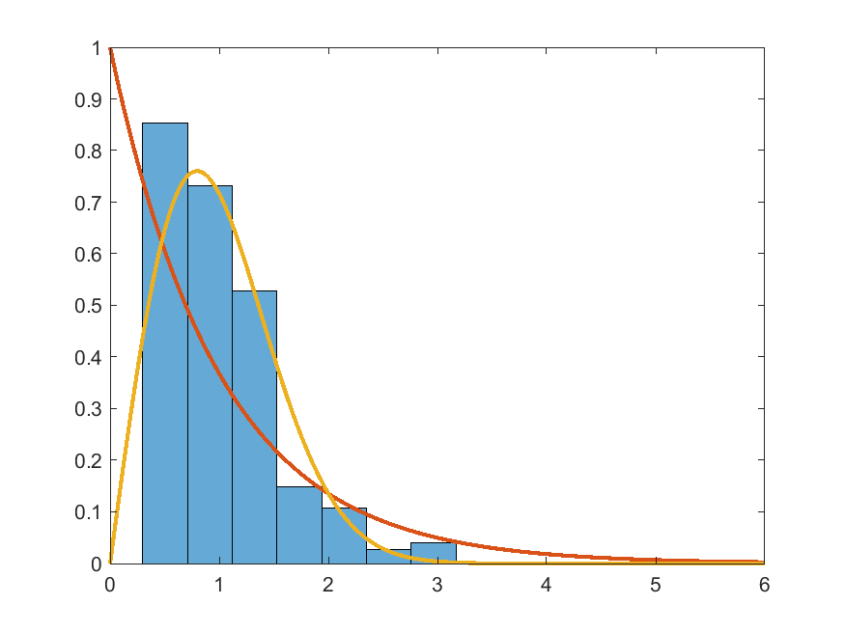
fine structure distribution in mm-wave

Slide 6
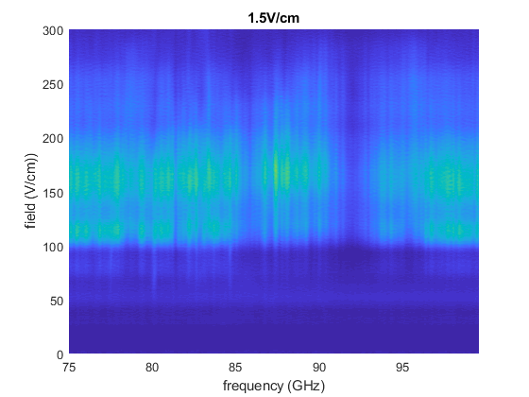
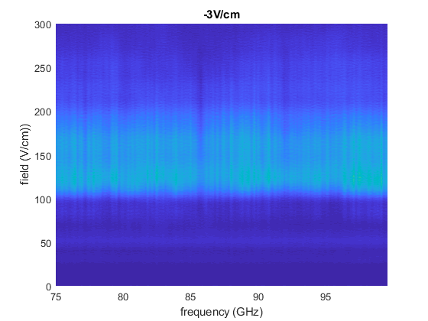
fine structure distribution in mm-wave

Slide 7



Model
New J. Phys. 21 043033
Phys. Rev. Lett.120, 110601
1D spin chain
Lindblad dynamics

Slide 8
Results of solving Lindblad equation N=7

